Slide 1

Vrinda Store: Customer and Sales Analysis
Vrinda Store's comprehensive analysis of customer demographics, sales performance, and geographic insights provides valuable information for strategic decision-making. This data-driven approach allows for targeted marketing campaigns, inventory optimization, and improved customer engagement across various segments.
VS
by Vicky Singh
Vikas Singh

Slide 2
Customer Demographics: Gender and Age
Gender Insights
Age Group Analysis
Women constitute the majority of customers, presenting an opportunity to tailor marketing campaigns, product recommendations, and store layouts to women's interests and shopping habits. Targeted approaches like exclusive promotions or loyalty programs for women could enhance engagement and customer retention.
Adult (30-50) and Youth (18-29) demographics are the most active shoppers, indicating strong purchasing power. Tailored promotions and product lines can be developed for these age groups, such as digital-first campaigns for younger audiences and email-based loyalty programs for adults.
Vikas Singh

Slide 3
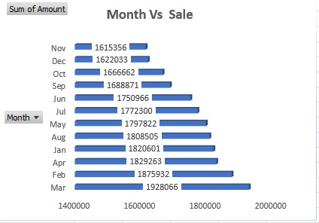
Sales Performance Analysis
1
Monthly and Seasonal Trends
December sees a spike in sales due to holiday shopping, while October experiences increased sales during festival seasons. This understanding helps optimize inventory planning and strategically time sales promotions.
2
Day of the Week Analysis
Higher sales on weekends, especially Saturdays and Sundays, suggest customers prefer shopping during leisure time. Weekend sales or flash deals can capitalize on this trend.
3
Year-over-Year Trends
Analyzing growth trends reveals if Vrinda Store's customer base and revenue are increasing, staying steady, or declining over time, aiding in long-term business forecasts and strategy adjustments.
Vikas Singh

Slide 4
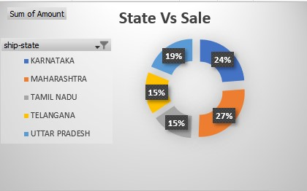
Geographic Insights
Top-Performing States
Top Cities
Karnataka, Maharashtra, and Tamil Nadu rank highest in sales, suggesting key regions for Vrinda Store's customer base. These areas may benefit from localized marketing campaigns, special offers, or potential future brick-and-mortar locations.
Major cities like Mohali, Gurugram, and Kolkata likely have dense customer clusters. Increased advertising in these cities, including targeted online ads, could further bolster sales. Distribution centers could be strategically placed closer to these high-demand areas for logistical efficiency.
Vikas Singh

Slide 5
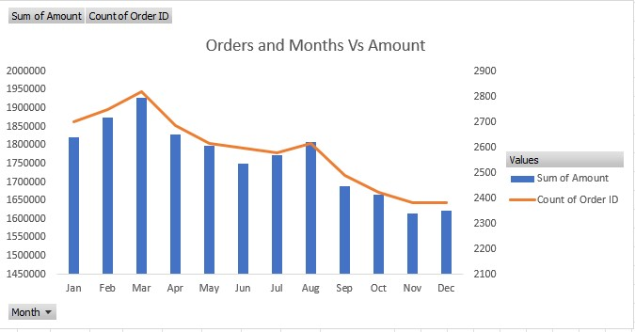
Order and Product Analysis
1
Average Order Value (AOV)
2
Quantity of Items per Order
AOV typically ranges from INR 500-1,500, indicating customers are purchasing relatively affordable items. This suggests a focus on mid-range priced products may resonate well with the customer base.
Most purchases are single-item orders, indicating customers buy only what they specifically need. Consider bundling products or offering discounts on multi-item purchases to incentivize higher order quantities.
Vikas Singh

Slide 6
B2B vs. B2C Sales
B2B Orders
Higher average order value, larger quantities, less frequent
B2C Orders
Majority of transactions, peak purchase times on weekends, slightly lower average order value
For B2B customers, Vrinda Store could offer bulk discounts, dedicated support, and fast shipping options. For B2C customers, weekend sales, loyalty rewards, and personalized recommendations can drive engagement. Highlighting customer reviews and product suggestions can enhance the shopping experience for these customers.
Vikas Singh

Slide 7

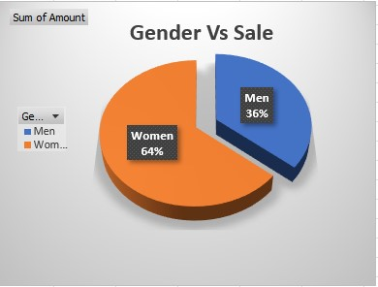

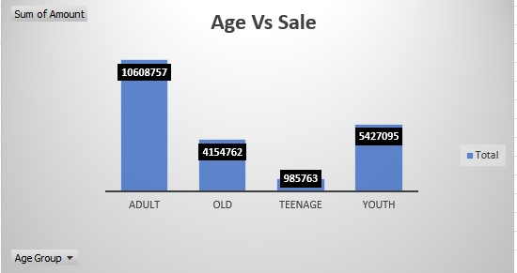

Gender and Age vs. Sales
Gender Trends
Sales trends may vary between men and women, possibly influenced by product type preferences or seasonal buying behavior. Understanding these trends enables targeted promotions and potentially gender-specific product recommendations.
Age Group Preferences
The Adult and Youth age groups may have different preferences, which can inform how products are marketed and packaged. Offering personalized or age-specific promotions could be effective.
Marketing Strategies
For younger audiences, social media campaigns can be beneficial, whereas older demographics might respond well to email marketing and loyalty programs.
Vikas Singh

Slide 8
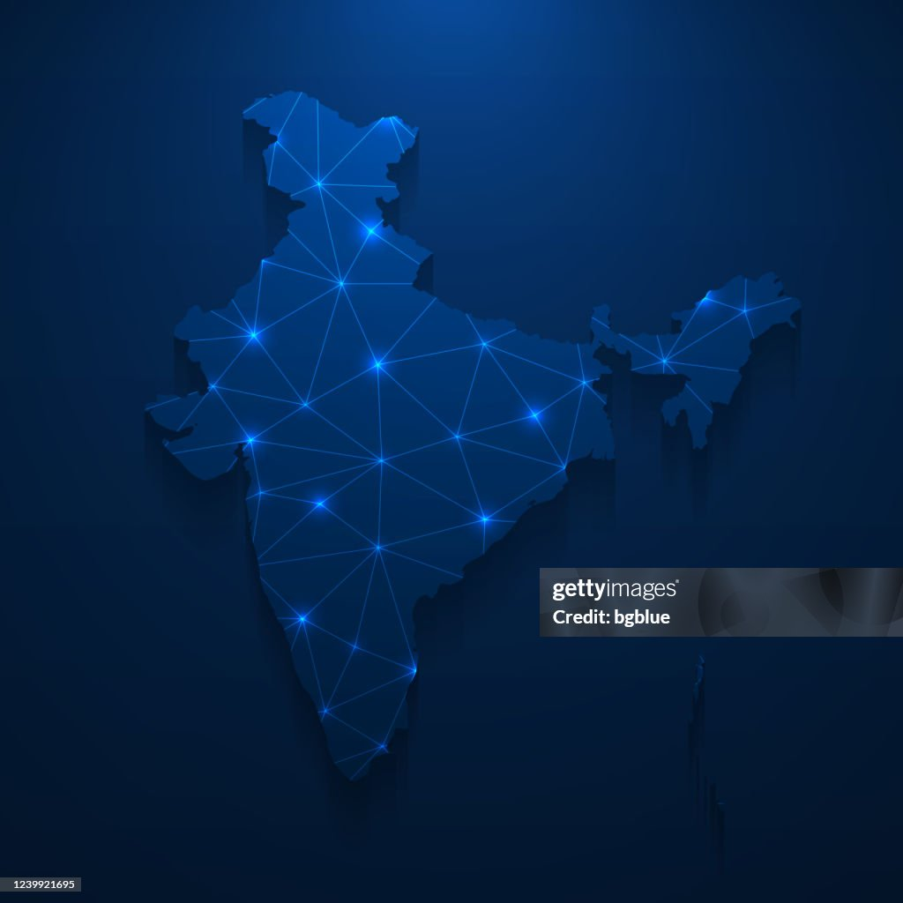



Top States and Order Status Analysis
Top States
The highest-selling states show demand hubs where targeted advertising could improve brand reach. These areas could be focal points for expanding advertising efforts or enhancing delivery options for faster shipping.
Order Status Analysis
Data on order statuses (e.g., completed, pending, or returned) can reveal potential issues in the ordering process. High return or cancellation rates might signal a need for improved product descriptions, sizing guides, or customer support enhancements.
Targeted Improvements
By focusing on top-performing states and addressing order status issues, Vrinda Store can optimize its operations and improve customer satisfaction across key markets.
Vikas Singh

Slide 9
Inventory and Regional Optimization
Peak Time Inventory
High-Demand Regions
Ensure high-demand products are well-stocked during peak months like December and around festivals. Use predictive analysis to anticipate stock needs and prevent stockouts during crucial sales periods.
Given the strong sales in specific cities and states, invest in local advertising and potentially reduce delivery times by setting up fulfillment centers closer to these regions. This approach can improve customer satisfaction and potentially increase sales in these key areas.
Vikas Singh

Slide 10
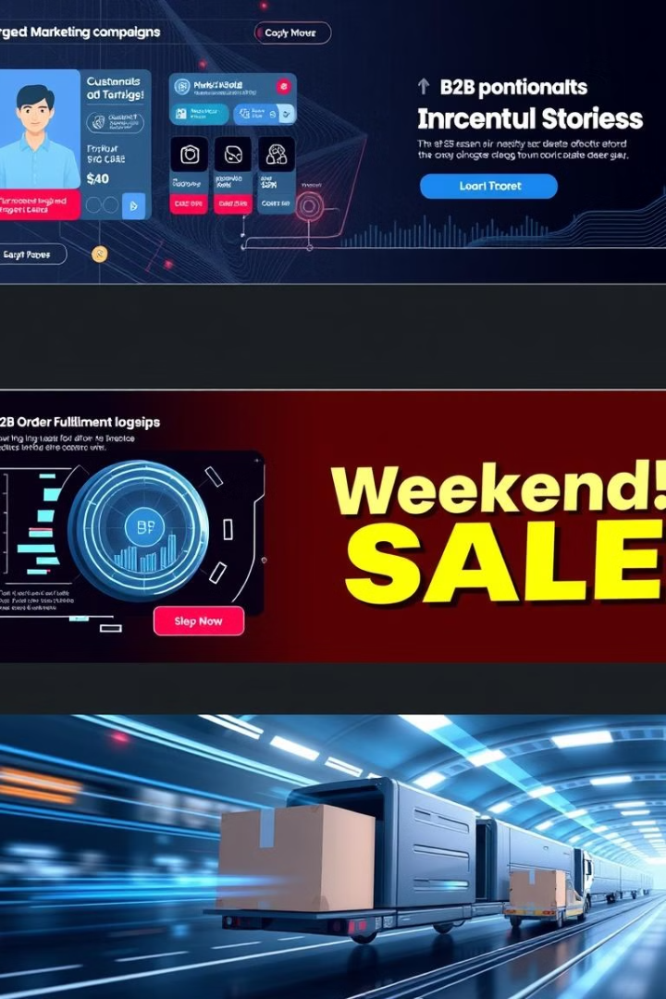
Marketing and B2B Strategies
Demographic-Targeted Marketing
Weekend Promotions
Since weekends drive higher sales, implement special promotions on Saturdays and Sundays. Flash sales, limited-time discounts, or free shipping on weekends could encourage more purchases and capitalize on peak shopping times.
Optimize marketing campaigns for the Adult and Youth age groups, as well as for women if they are the primary customers. Consider running exclusive offers tailored to these demographics to boost sales and customer loyalty.
Expand B2B Offerings
Given the higher order values in B2B sales, enhance services for business customers by offering dedicated support, bulk order discounts, and faster shipping options to attract and retain more B2B clients.
Vikas Singh

